Slide 1
Ball on ferrite rod
11

Slide 2
Table of contents
Observations
Models
Introduction
Summary
Simulation
Problem definition
Phenomenon explanation
Measurement of resonant frequency
Experiment
Simulation
Limitations
Summary
Gymnázium Christiana Dopplera a Gymnázium Cheb – team GCh(D+1)

Slide 3
Problem definition
Introduction
Observations
Models
Summary
Simulation
EN: A ferrite rod is placed at the bottom end of a vertical tube. Apply an ac voltage, of a frequency of the same order as the natural frequency of the rod, to a fine wire coil wrapped around its lower end. When a ball is placed on top of the rod, it will start to bounce. Explain and investigate this phenomenon.
CZ: Umístěte na spodní konec feritové tyčky cívku navinutou z tenkého drátu a vložte tyčku do svislé trubky. Přiložte na cívku střídavé napětí o frekvenci stejného řádu, jako je vlastní frekvence tyčky. Položíte-li na horní konec tyčky v trubce kuličku, začne poskakovat. Vysvětlete a prozkoumejte tento jev.
Gymnázium Christiana Dopplera a Gymnázium Cheb – team GCh(D+1)

Slide 4
Phenomenon explanation
Introduction
Observations
Models
Summary
Simulation
Based on longitudinal magnetostriction of the ferrite rod
Close-to-resonant oscillation of the ferrite can then produce forces large enough to propel a small ball
The material of the ball should have a high Young‘s modulus and a high coefficient of restitution for the best effect – steel, glass
The system seems to act in a chaotic manner
Gymnázium Christiana Dopplera a Gymnázium Cheb – team GCh(D+1)

Slide 5
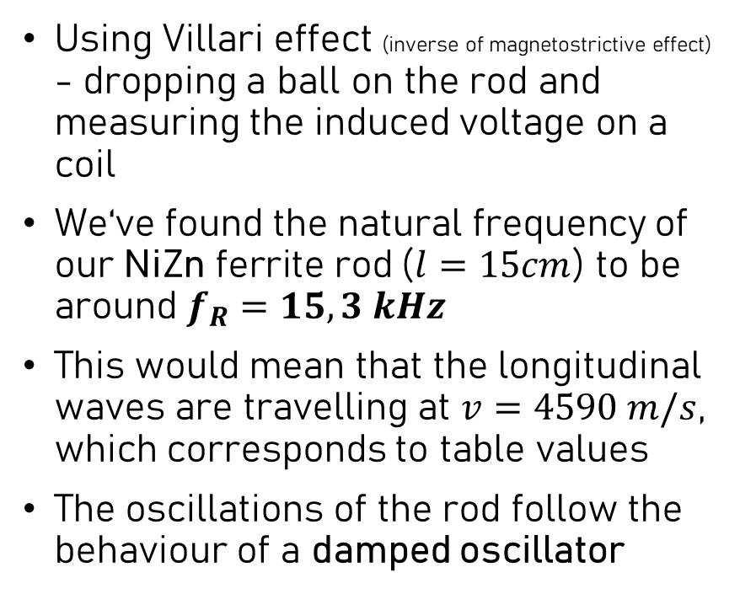
Measurement of resonant frequency
Introduction
Observations
Models
Summary
Simulation
Using Villari effect (inverse of magnetostrictive effect) - dropping a ball on the rod and measuring the induced voltage on a coil
We‘ve found the natural frequency of our NiZn ferrite rod ($l=15cm$) to be around $f_{R}=15,3 kHz$
This would mean that the longitudinal waves are travelling at $v=4590 m/s$, which corresponds to table values
The oscillations of the rod follow the behaviour of a damped oscillator
Gymnázium Christiana Dopplera a Gymnázium Cheb – team GCh(D+1)
Notes:
f ve grafu je 2*fR, protože magnetostrikce je jako abs. hodnota

Slide 6
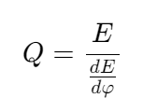
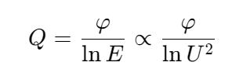
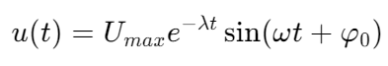
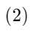
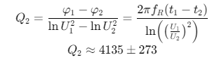
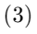
Measurement of Q factor
Introduction
Observations
Models
Summary
Simulation
Since the rod is behaving like a damped oscillator, we can calculate the Q factor:
We can then model our measured voltage as:
And finally read out values from out measurement and calculate the Q factor:
The fact that the Q factor is so high means:
The system is losing energy very slowly
The resonance bandwidth is relatively small
Gymnázium Christiana Dopplera a Gymnázium Cheb – team GCh(D+1)
Notes:
f ve grafu je 2*fR, protože magnetostrikce je jako abs. hodnota

Slide 7
Measurement of Q factor
Introduction
Observations
Models
Summary
Simulation
Even though the magnetostrictive effect is very small, the high Q factor allows for build-up of energy and strong oscillations

Slide 8
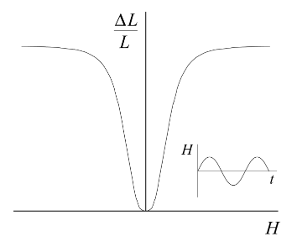
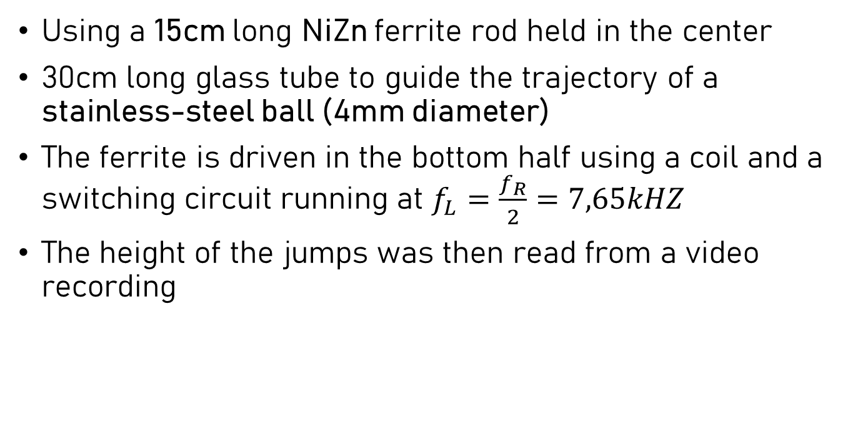
Experiment apparatus
Introduction
Observations
Models
Summary
Simulation
Using a 15cm long NiZn ferrite rod held in the center
30cm long glass tube to guide the trajectory of a stainless-steel ball (4mm diameter)
The ferrite is driven in the bottom half using a coil and a switching circuit running at $f_{L}=\frac{f_{R}}{2}=7,65kHZ$
The height of the jumps was then read from a video recording
Fig. 3: ∆L/L vs. H curve [1]

Slide 9
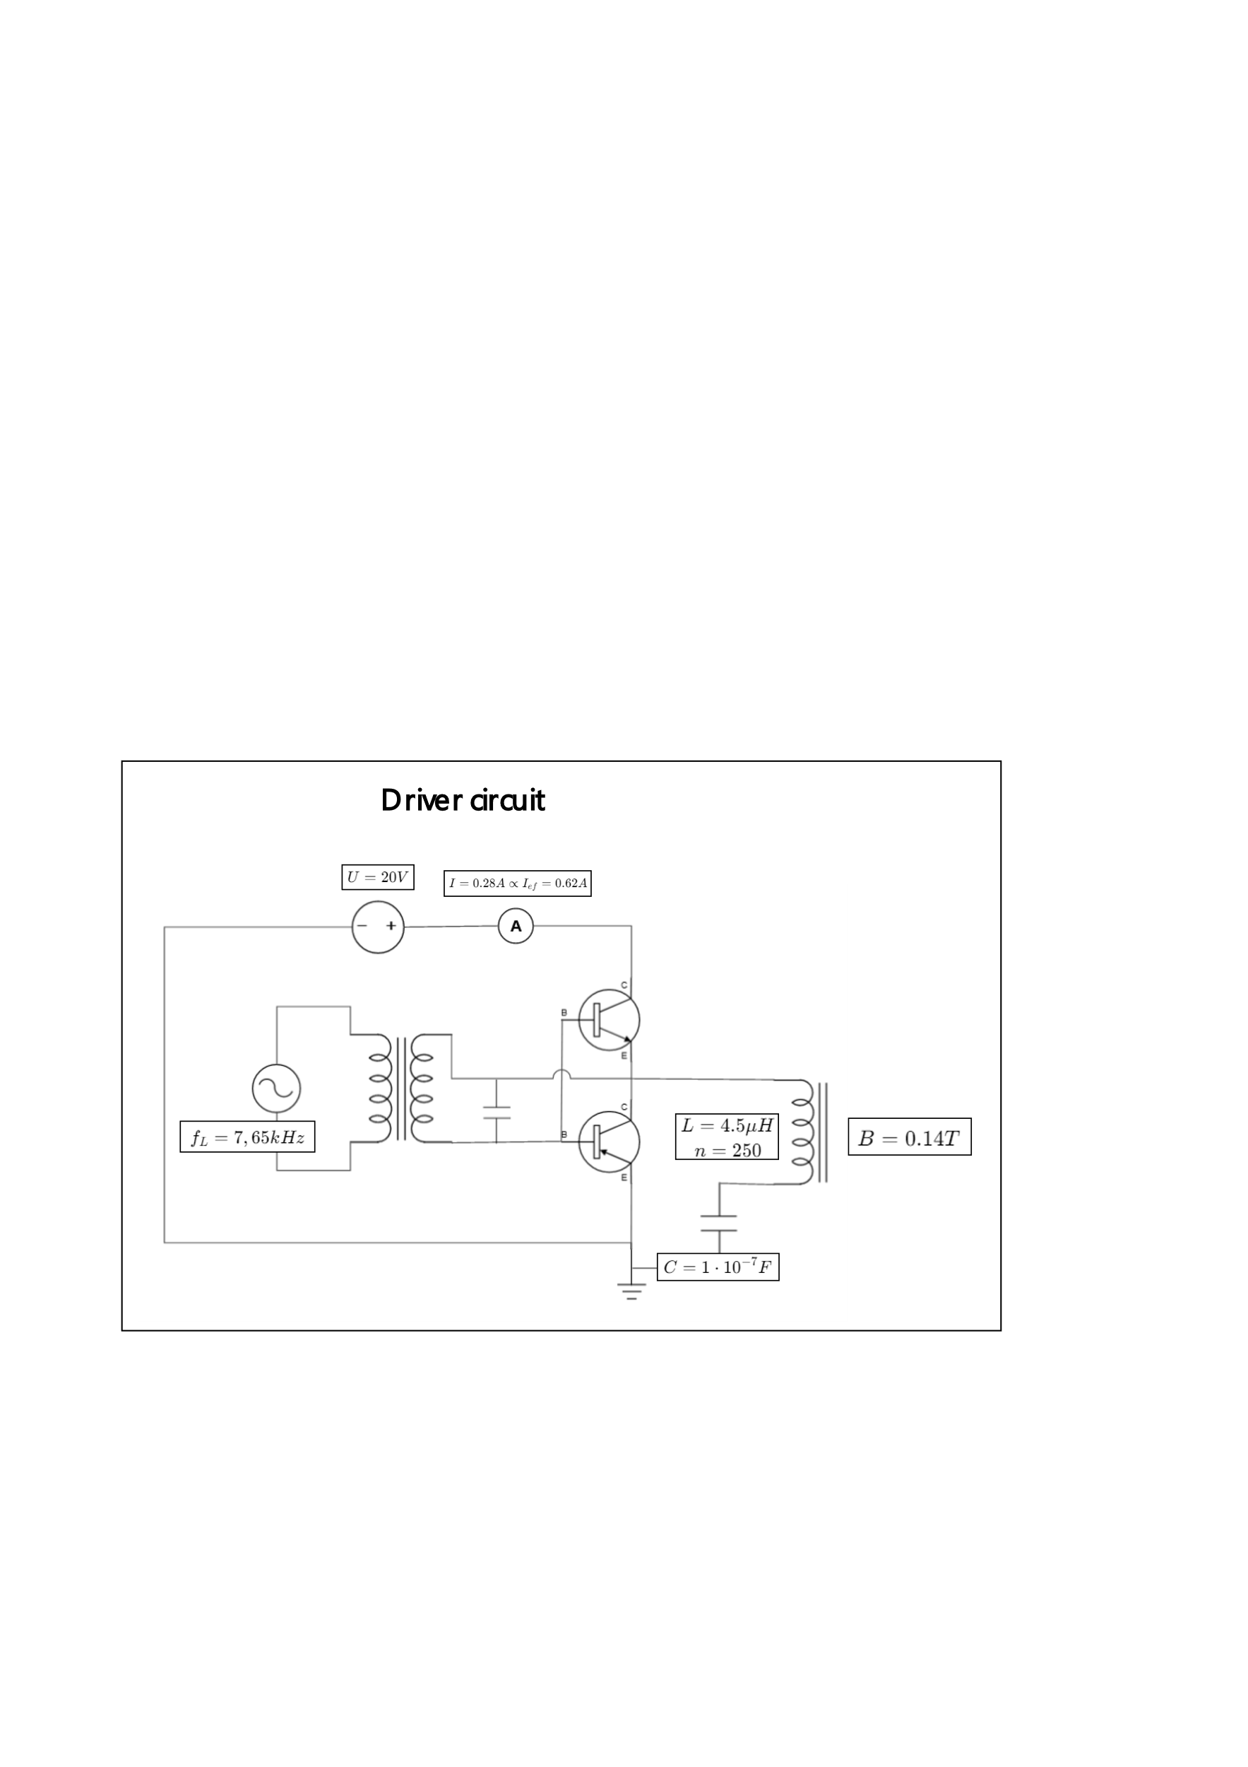
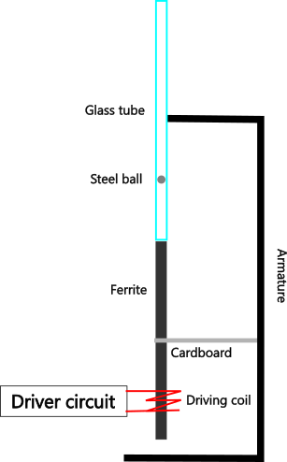
Experiment apparatus
Introduction
Observations
Models
Summary
Simulation
Fig. 4: Circuit diagram of the driver circuit
Fig. 5: Experiment diagram

Slide 10
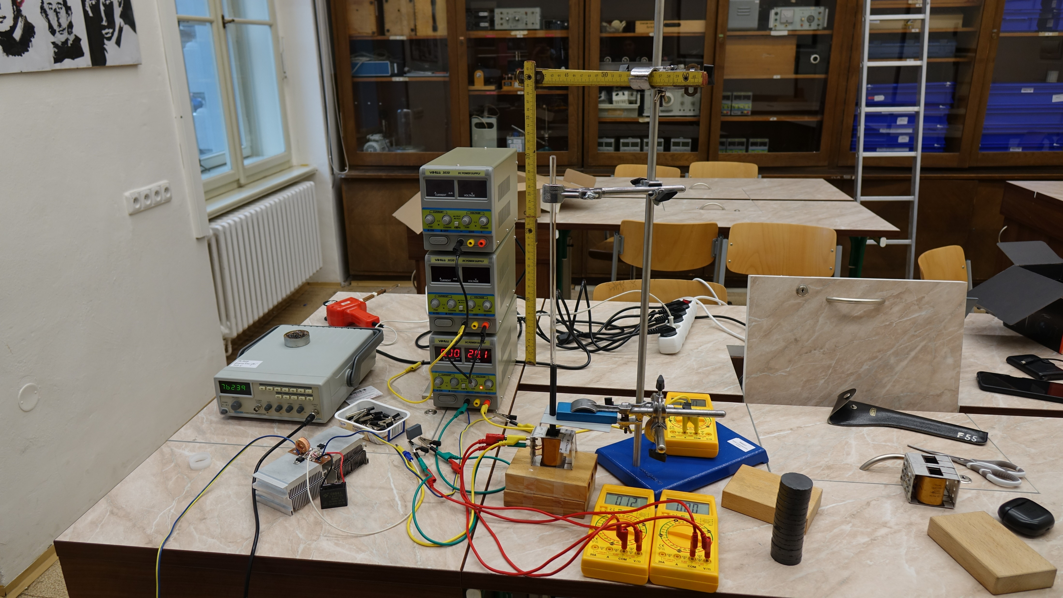
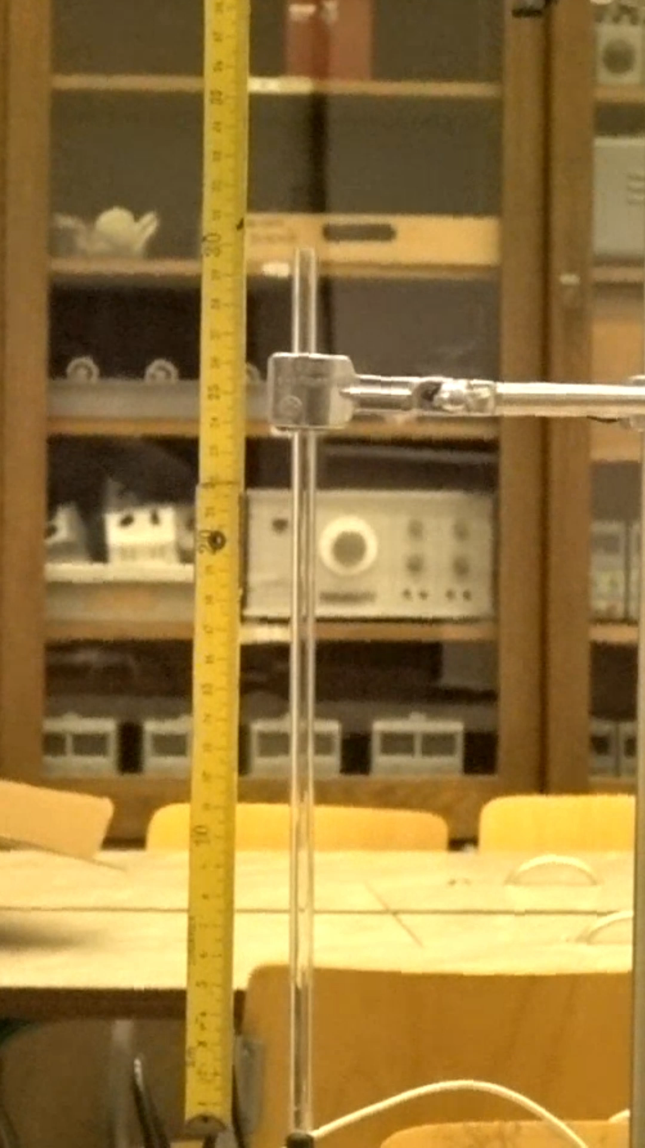
Experiment apparatus
Introduction
Observations
Models
Summary
Simulation

Slide 11
Experiment results
Introduction
Observations
Models
Summary
Simulation
400 measured jumps (cca 2 minutes of video)
Starting height: 10cm

Slide 12
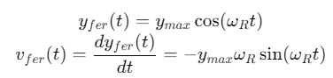
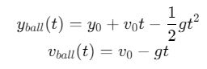
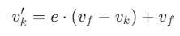
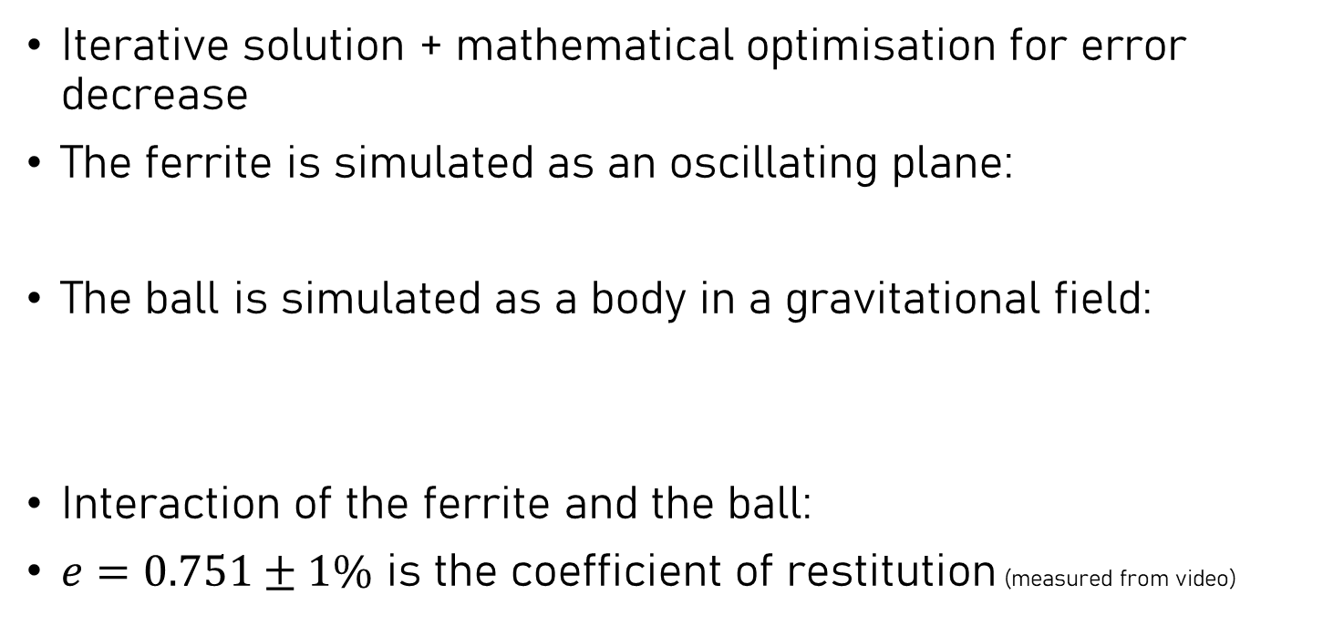
Simulation
Introduction
Observations
Models
Summary
Simulation
Iterative solution + mathematical optimisation for error decrease
The ferrite is simulated as an oscillating plane:
The ball is simulated as a body in a gravitational field:
Interaction of the ferrite and the ball:
$e=0.751±1\%$ is the coefficient of restitution (measured from video)

Slide 13
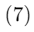
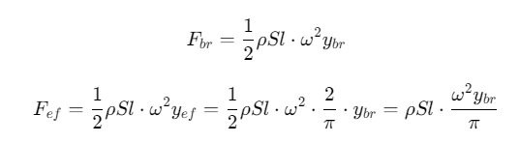
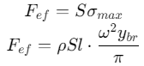
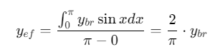
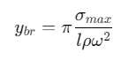
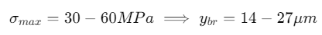

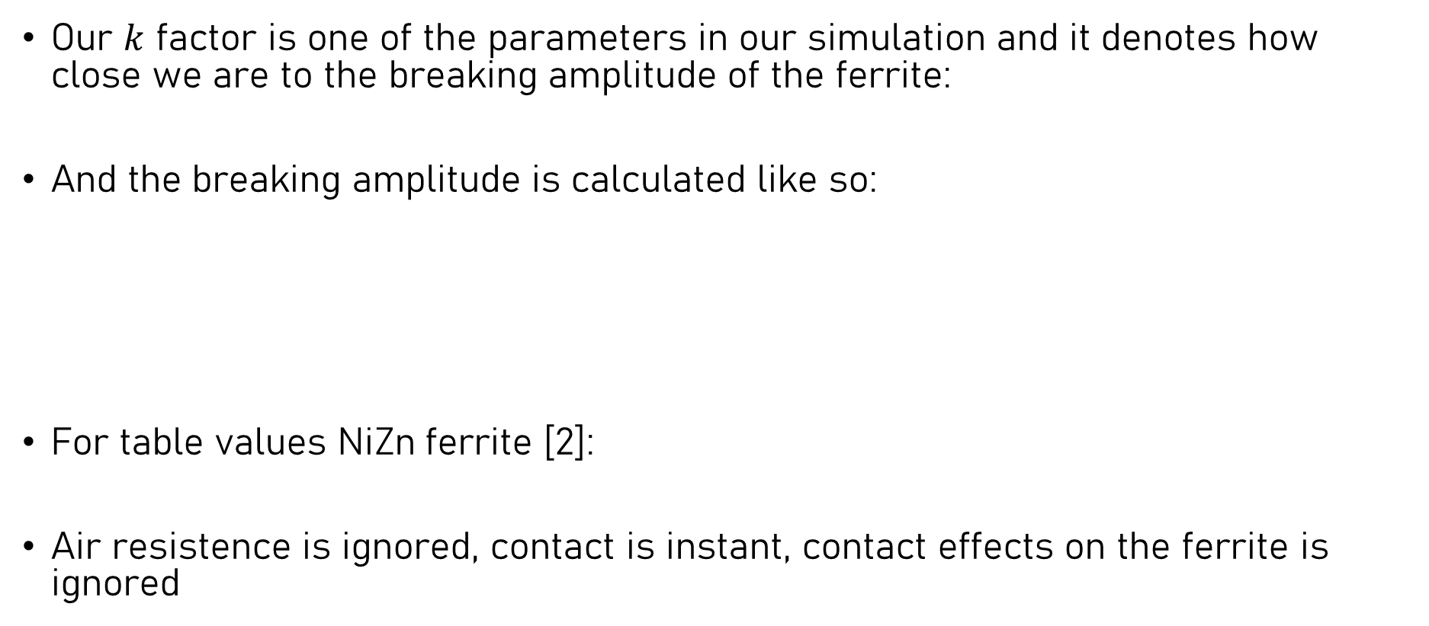
Simulation
Introduction
Observations
Models
Summary
Simulation
Our $k$ factor is one of the parameters in our simulation and it denotes how close we are to the breaking amplitude of the ferrite:
And the breaking amplitude is calculated like so:
For table values NiZn ferrite [2]:
Air resistence is ignored, contact is instant, contact effects on the ferrite is ignored
$$k=\frac{y_{max}}{y_{br}}$$

Slide 14
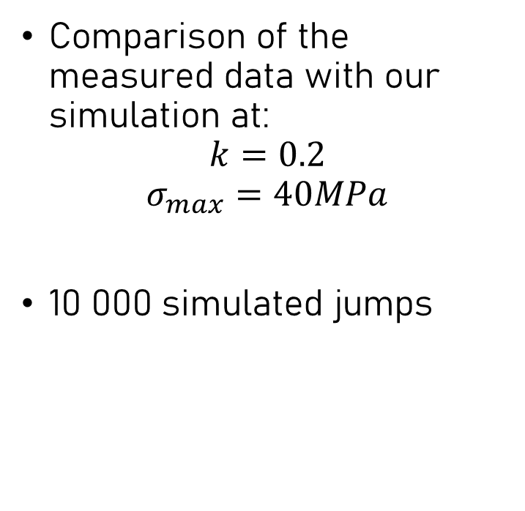
Simulation vs experiment
Introduction
Observations
Models
Summary
Simulation
Comparison of the measured data with our simulation at:
$$k=0.2$$
$$σ_{max}=40MPa$$
10 000 simulated jumps

Slide 15
Simulation – k factor
Introduction
Observations
Models
Summary
Simulation

Slide 16
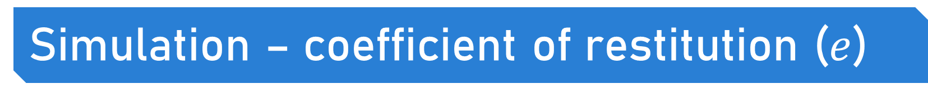
Simulation – coefficient of restitution ($e$)
Introduction
Observations
Models
Summary
Simulation

Slide 17
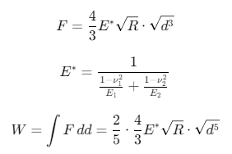
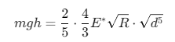
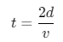
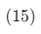
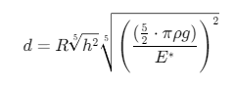
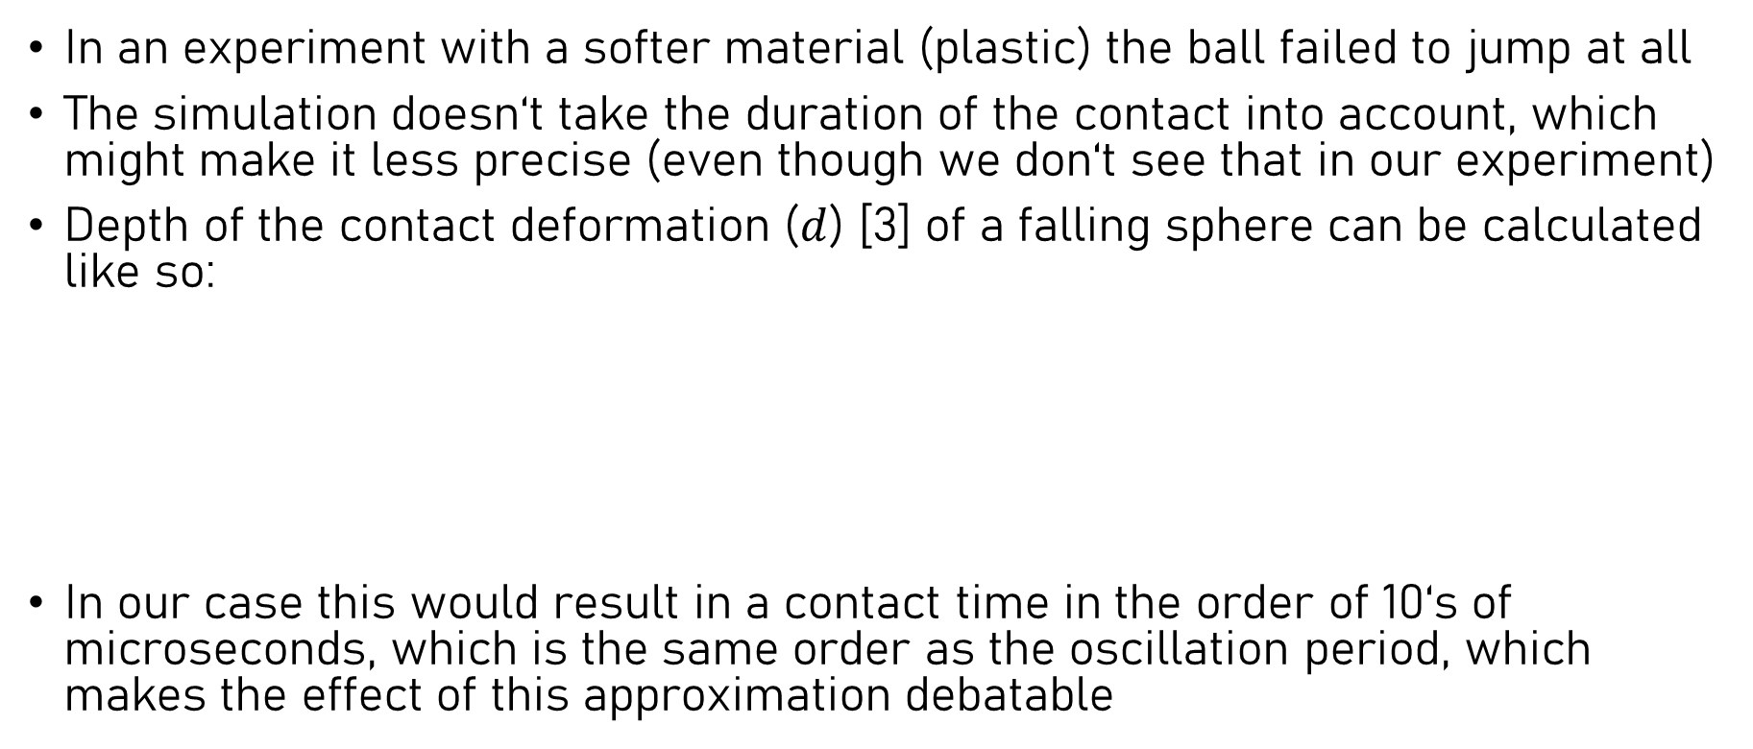
Limitations
Introduction
Observations
Models
Summary
Simulation
In an experiment with a softer material (plastic) the ball failed to jump at all
The simulation doesn‘t take the duration of the contact into account, which might make it less precise (even though we don‘t see that in our experiment)
Depth of the contact deformation ($d$) [3] of a falling sphere can be calculated like so:
In our case this would result in a contact time in the order of 10‘s of microseconds, which is the same order as the oscillation period, which makes the effect of this approximation debatable
Notes:
Proportionality of d to R is interesting

Slide 18
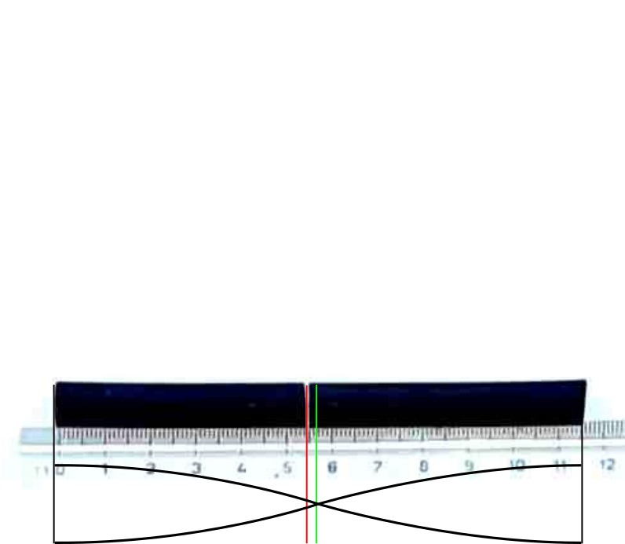
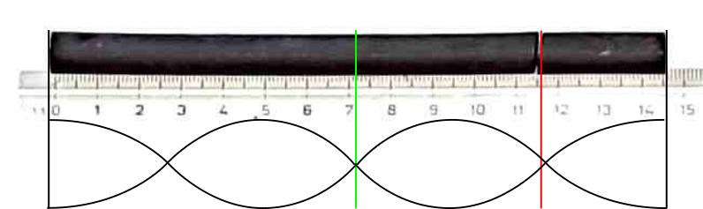
Limitations
Introduction
Observations
Models
Summary
Simulation
One of the main limitations is the maximum amplitude of the oscillations before the ferrite breaks:

Slide 19
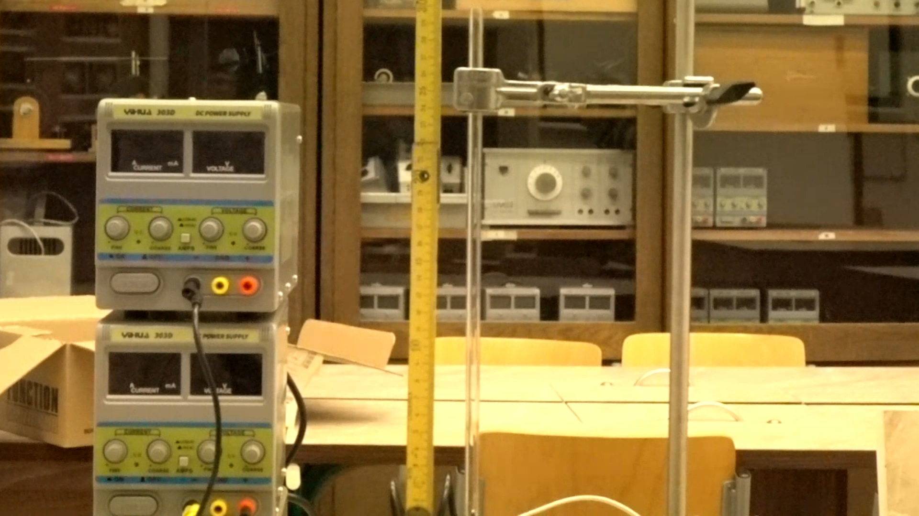
Limitations – obscure stopping
Introduction
Observations
Models
Summary
Simulation
Sometimes the ball abruptly stops
The only way we found to get it running again is via a horizontal magnetic field
Mechanical interaction didn‘t help in solving the issue either

Slide 20
Summary
Introduction
Observations
Models
Summary
Simulation
The main phenomena in this task are: magnetostriction, resonance, chaos
The resonant frequency of our rod was found using the Villari effect and a circuit to drive such resonance has been successfully built and used
An experiment has been devised along with a simulation model, which satisfiably matches our measurements
We‘ve analyzed the behaviour of some relevant paramaters and how they behave in our model
We‘ve discovered some limitiations of our solution
A phenomenon which we‘ve not been able to explain was observed

